Slide 1

Welcome Back Campaign
23rd June – 31st August 2020

Slide 2

Summary
On 23rd June, following the Prime Minister’s confirmation of the 4th July re-opening date, the ERBID launched the Welcome Back campaign targeting both Day and Stay visitors.
The campaign was purely digital and used Google Search, Google Display, Facebook and Instagram advertising.
Results:
  Impressions: 9,638,401
  Clicks to the website: 95,115
  Spend: £9,300.31

Slide 3

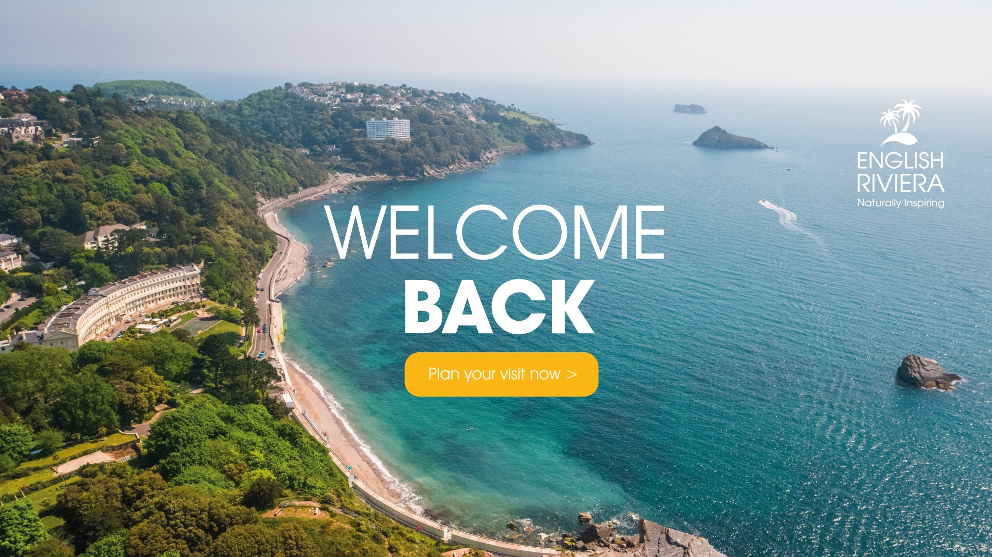

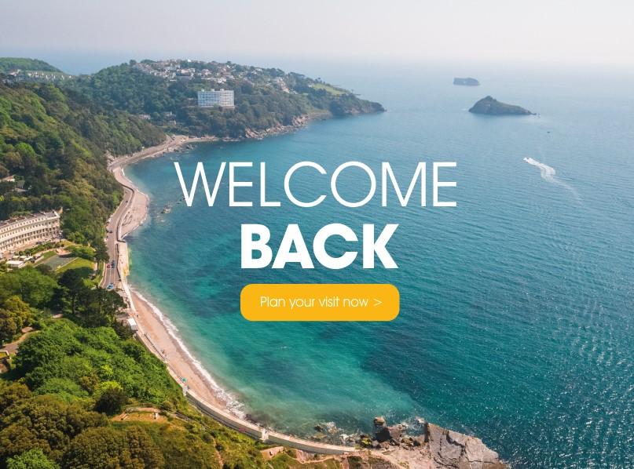
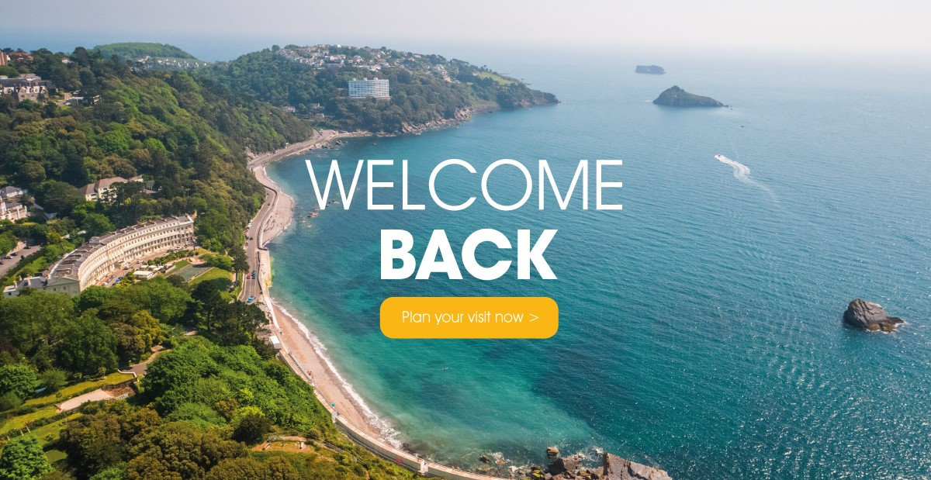
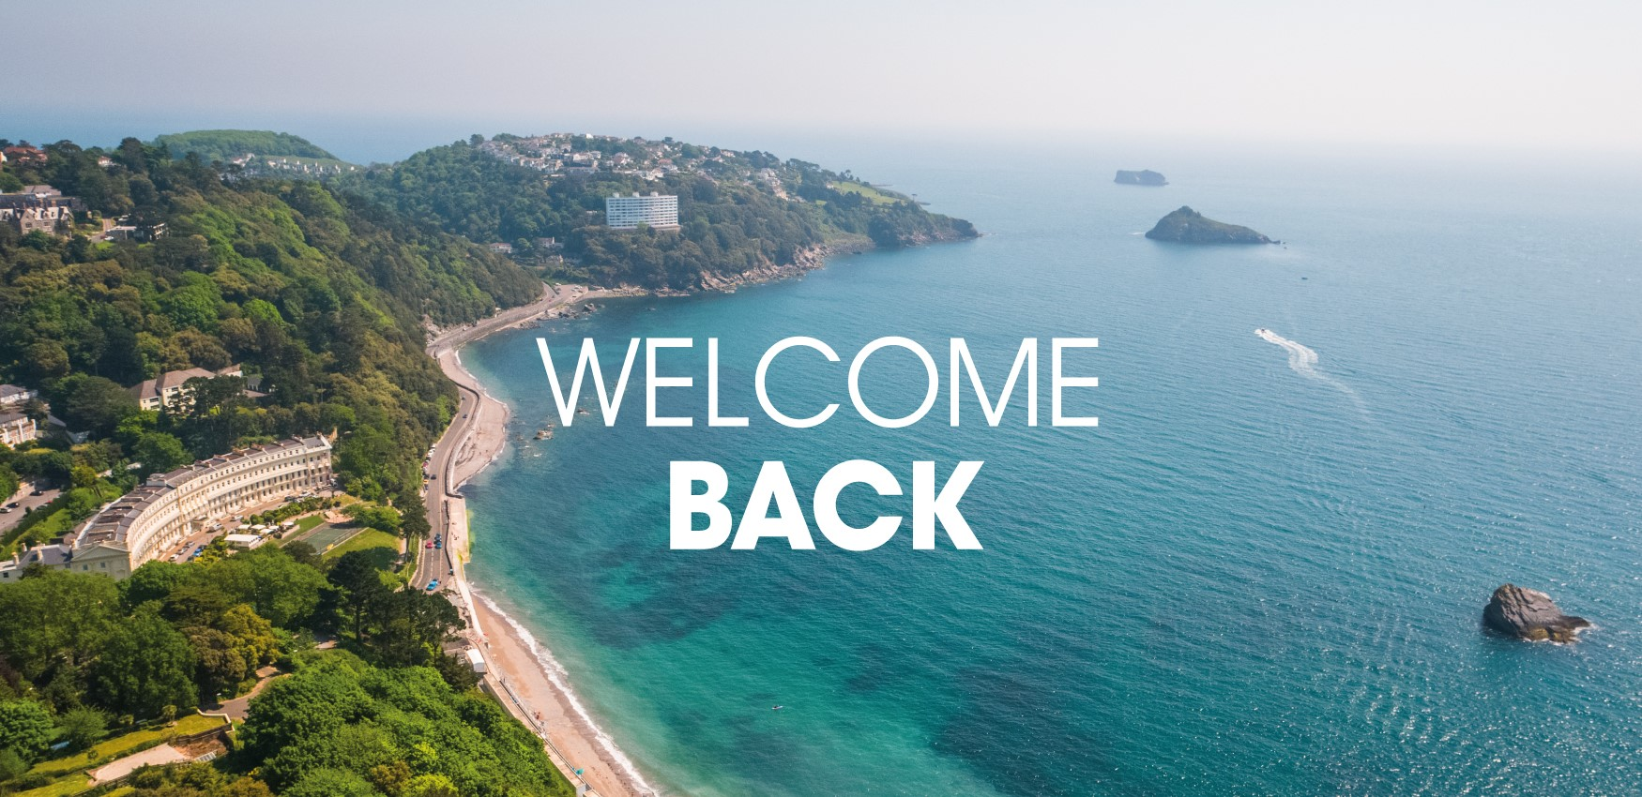

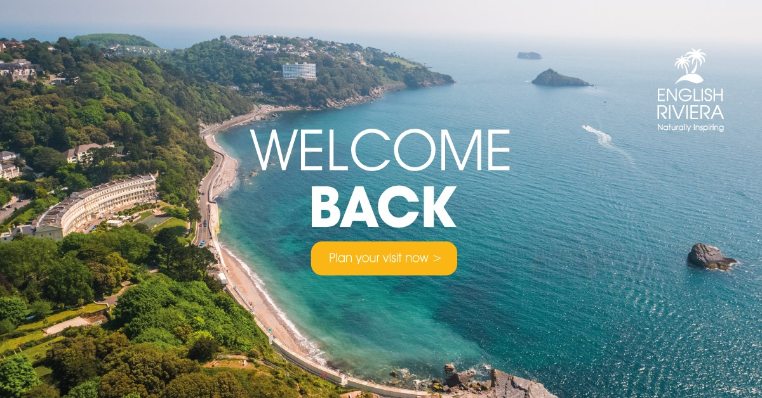

Campaign Assets

Slide 4
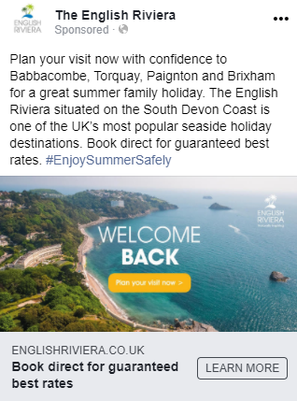
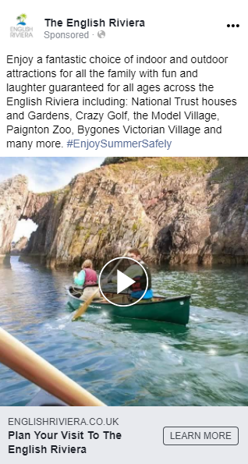
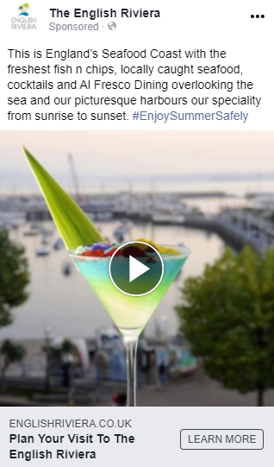
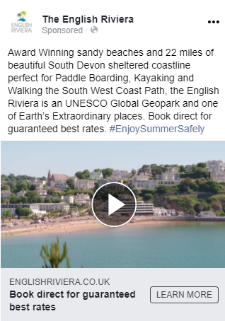
Digital Advertising
A range of digital advertising platforms were used as they each provide different benefits:
Google Search: provides high click through rates.
Google Display: provides high impressions thereby increasing awareness.
Facebook and Instagram: both provide good click through rates, high awareness and allows for engagement.
Additionally, four different adverts and advert copy was used, highlighting different aspects of the English Riviera offering, which you can see opposite.

Slide 5
Digital Advertising Results
Advertising platform | Impressions | Clicks | Click through rate | Spend
Google Search | 241,543 | 38,477 | 15.93% | £1,943.75
Google Display | 6,952,269 | 3,555 | 0.05 | £1,496.87
Facebook and Instagram | 2,444,589 | 53,083 | 2.17% | £5,574.69
TOTALS | 9,638,401 | 95,115 | 7.70% average | £9,015.31

Slide 6
Website
The paid advertising campaign directed traffic to multiple webpages:
  Home page: pageviews increased by 214% compared to last year.
  Things To Do: pageviews increased by 209% compared to last year.
  Food & Drink: pageviews increased by 68% compared to last year.
The entire website also saw a tremendous increase in traffic during this period (23rd June – 31st August 2020) up 27% on users and 28% on pageviews compared to the same period last year.

Slide 7
Spend
The total spend for this campaign has been detailed below:
  Design of campaign assets: £285
  Google Search Advertising: £1,943.75
  Google Display Advertising: £1,496.87
  Facebook and Instagram Advertising: £5,574.69
  TOTAL: £9,300.31

